Slide 1
Competitive Cyber Security Organization
Lockpicking
GRAB A SEAT UP FRONT!
By attending today’s meeting you acknowledge that you may be photographed or recorded for club use

Slide 2


Announcements
Open CPTC Practice / Rack Dry Run
Next Wednesday Oct 16th from 6-9pm E339
HackPSU Workshop – SIEMs
Saturday Oct 12th 2-3pm @HackPSU
ISTS Application Form
Merch Order – Soon!

Slide 3
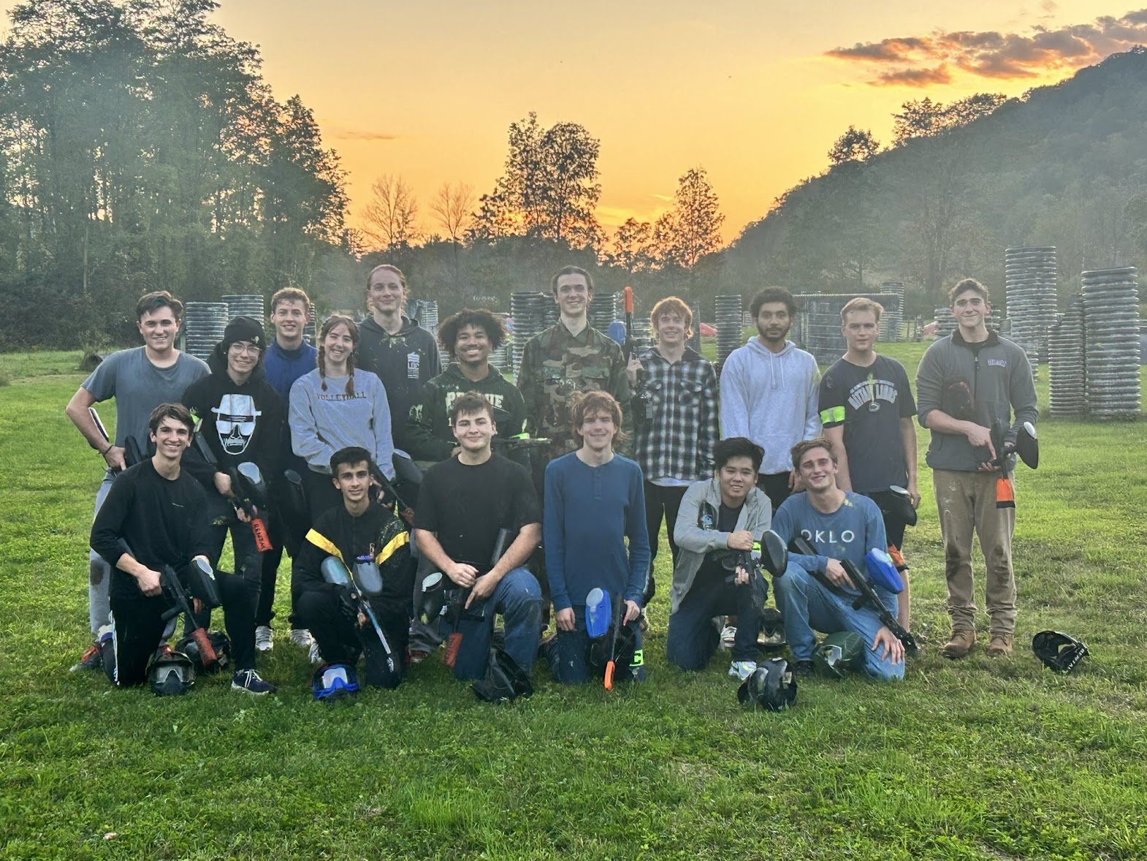
Paintball Social Last Week!

Slide 4
Learning Objectives:
Anatomy of a lock
Types of locks
Picking techniques
Lock bypassing
Practice Time :)
Diagrams and images sourced from toool

Slide 5
Safety Disclaimer
We're teaching skills for the purpose of education and protection
Know the law; depending on your state some of these tools carry a felony for simple possession or intent
Some techniques may cause damage, do not practice on equipment that you don't own
We do not endorse any criminal activity

Slide 6
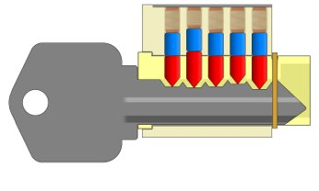
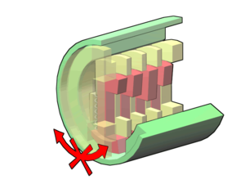
Common Lock Types
Pin Tumbler
Most doors in the US
Wafer
Cars, Lockers
Tubular
Bikes, Vending Machines
Disc Detainer
Warded
Lever

Slide 7
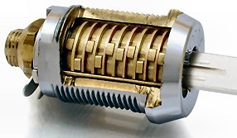
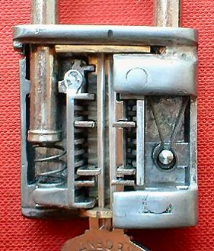
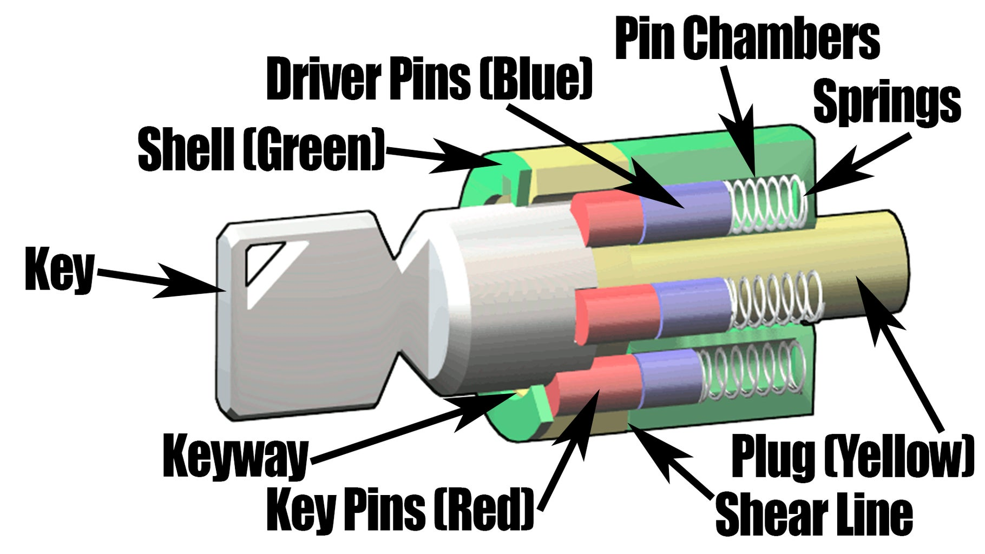
More Lock Pictures

Slide 8
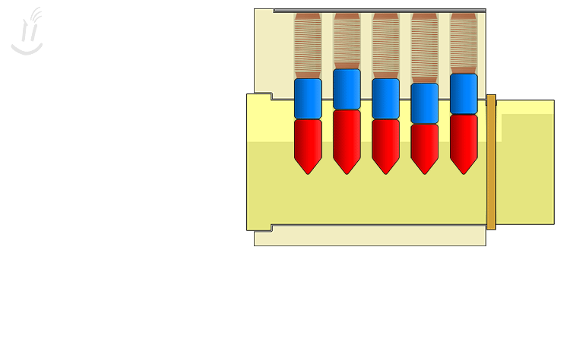
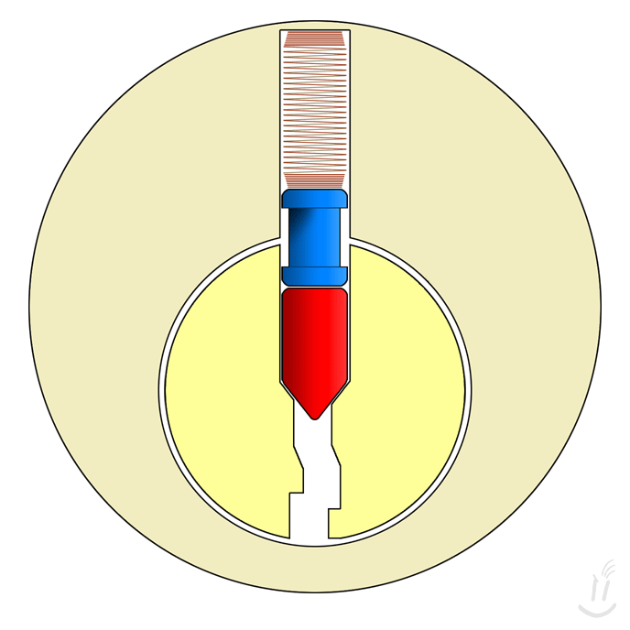
Pin Tumbler Locks
Cylinder, Keyway, Driver Pin, Key Pin, Springs
Keys move pins to the shear line + turn the lock

Slide 9
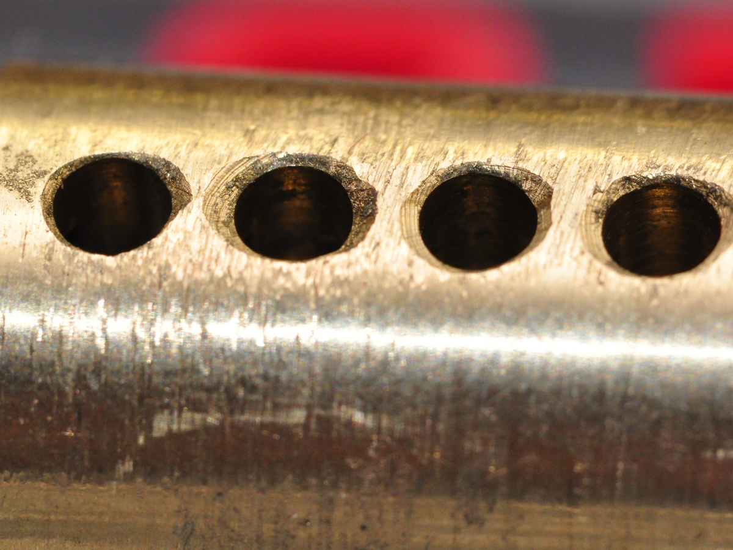
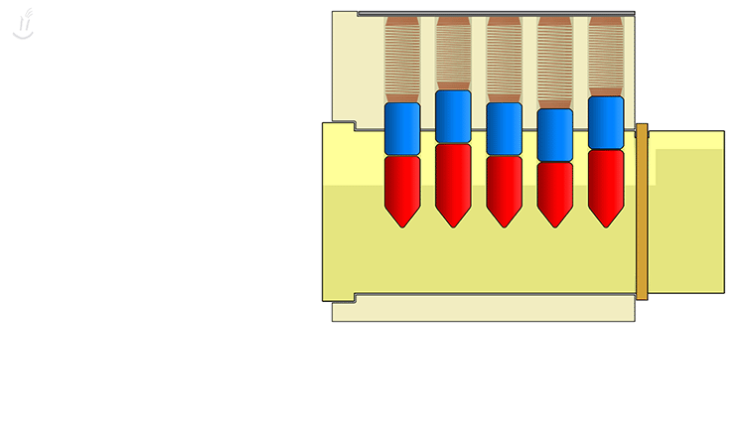
Picking Pin Tumbler Locks
Preys on manufacturing tolerances
Apply turning force
Go through pins until they bind
Rinse and repeat

Slide 10
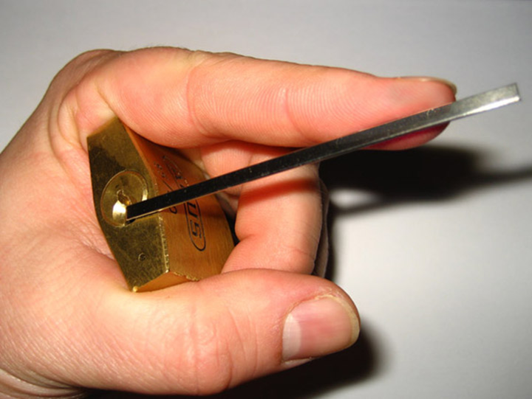
Applying Turning Force

Slide 11
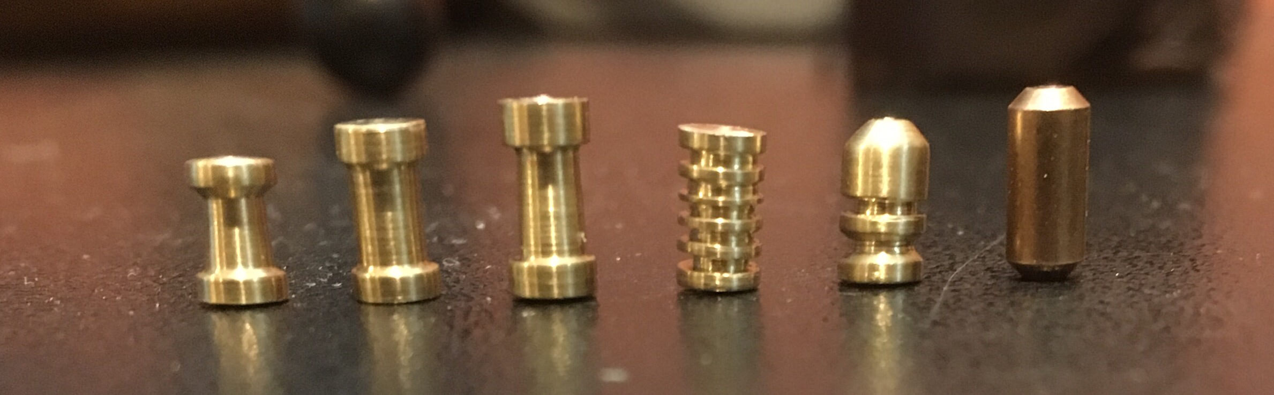
Security Pins
Changes how the pick interacts with the pins
Spool, serrated, mushroom, etc.

Slide 12
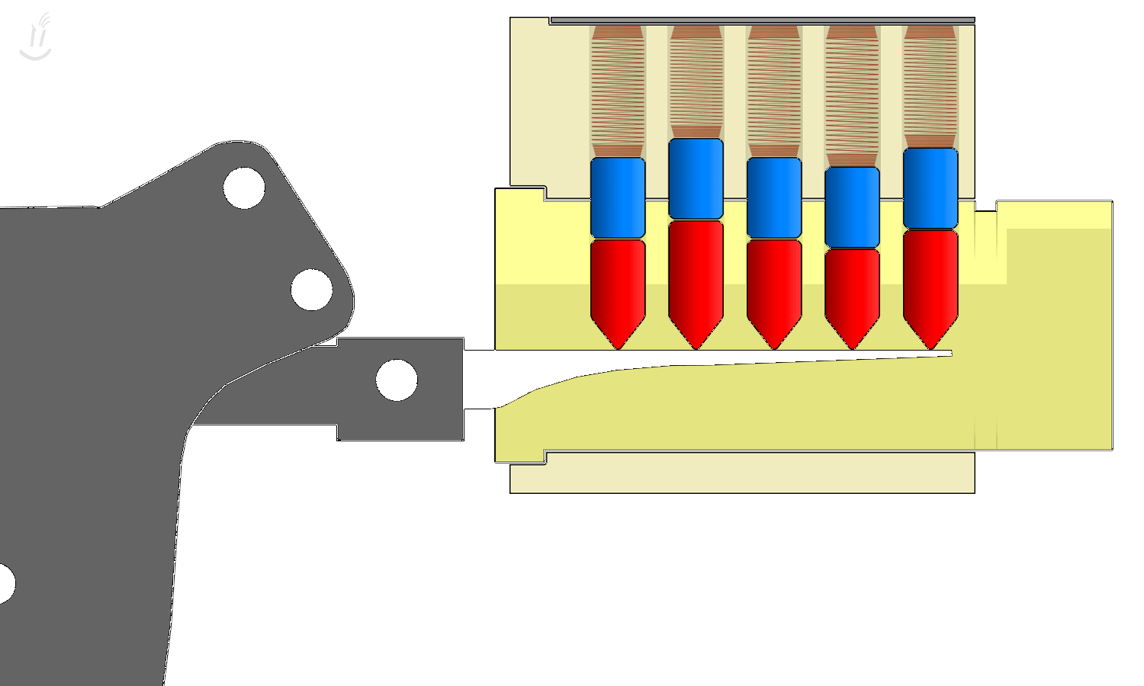
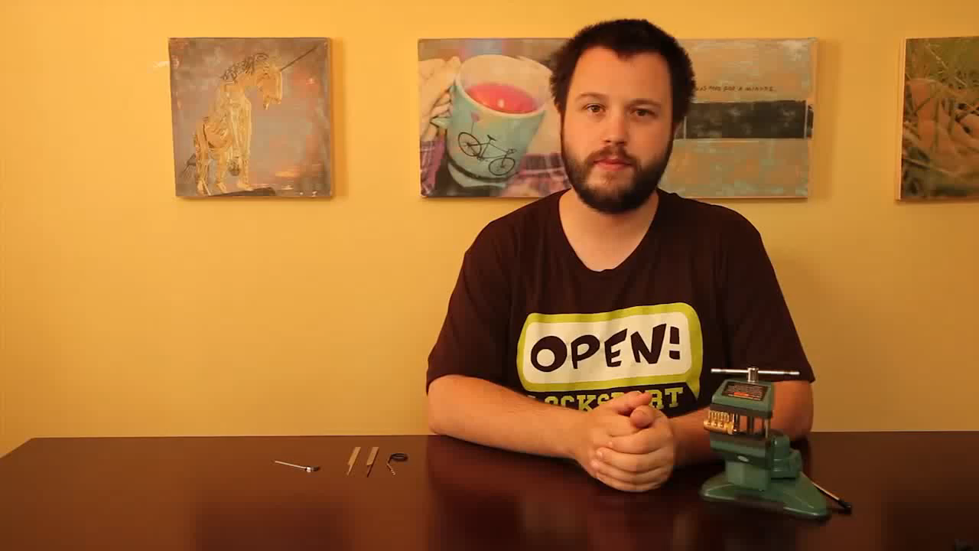
Rakes, Jigglers, and Bumping
Not precise, quickly move pins into position

Slide 13
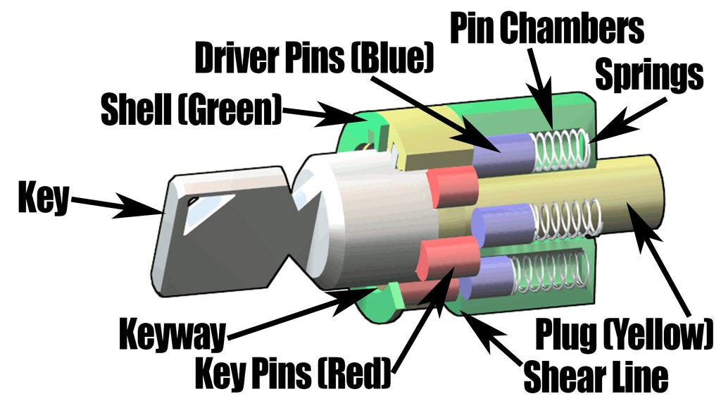
Tubular Locks

Slide 14
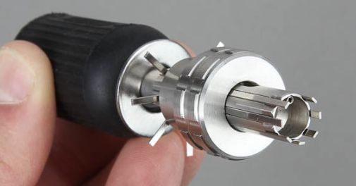
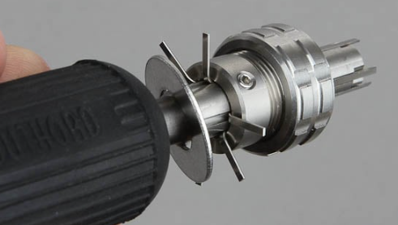
Picking Tubular Locks

Slide 15
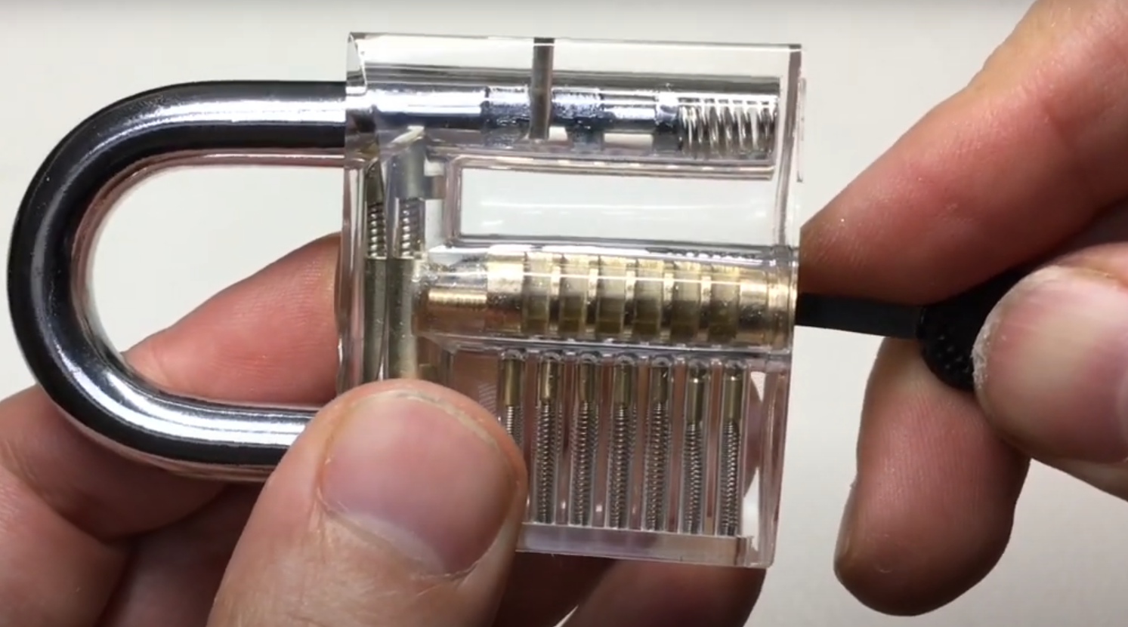
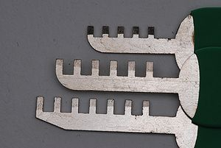
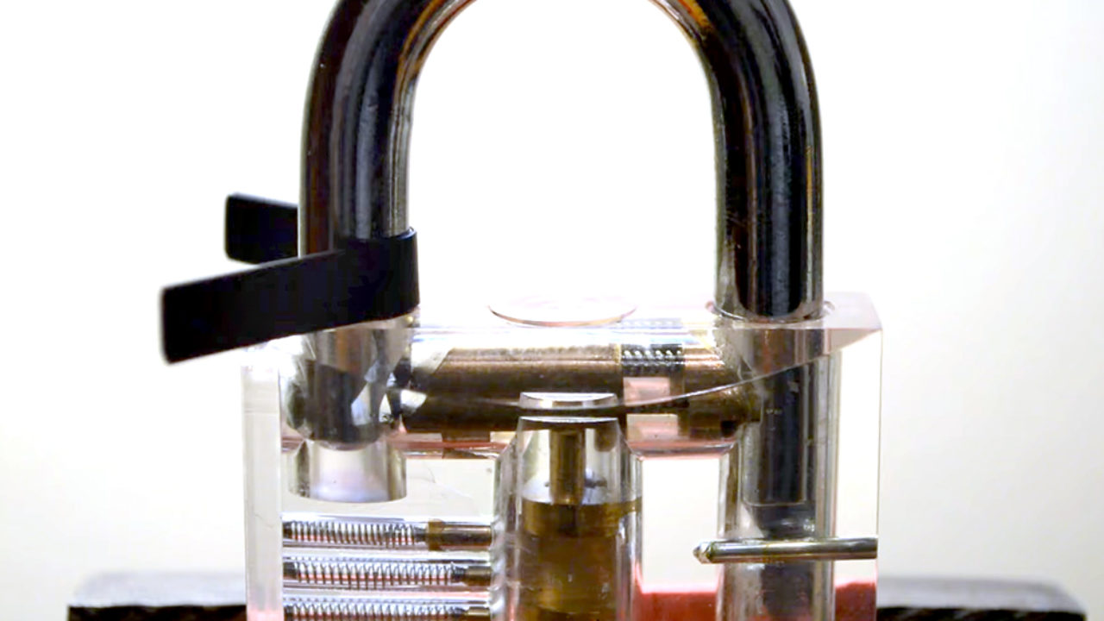
Bypassing Locks
Unshielded keyways
Combing
Padlock Shimming
Decoding + Impressioning

Slide 16
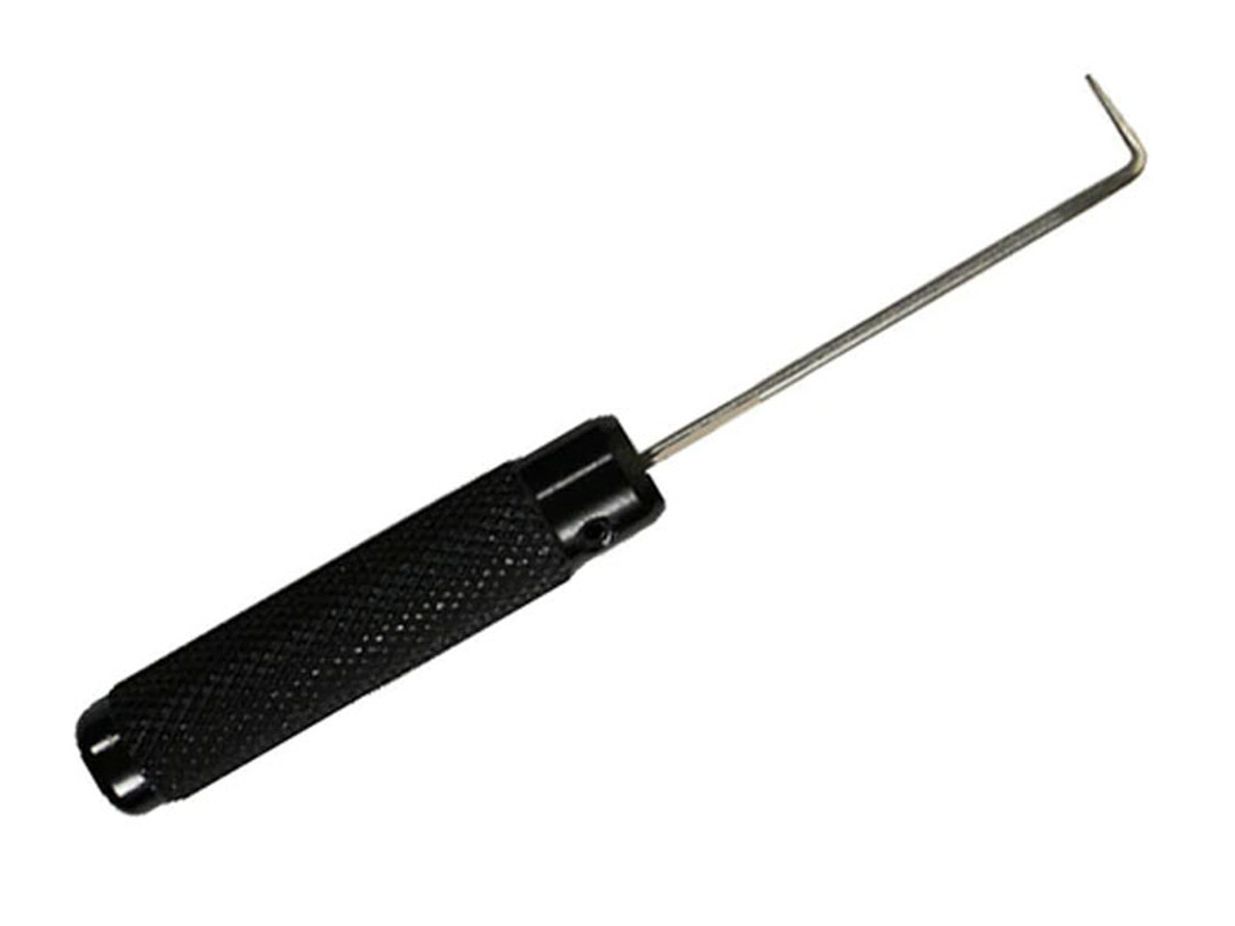
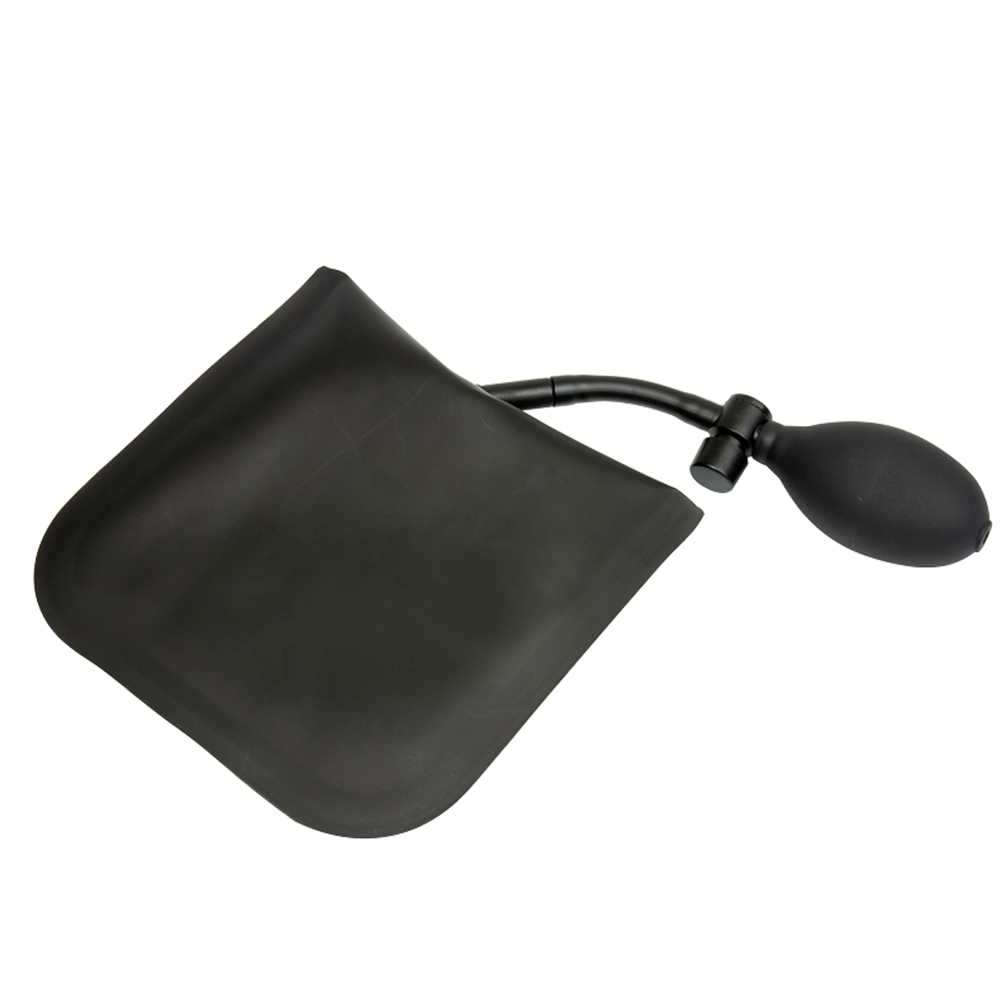
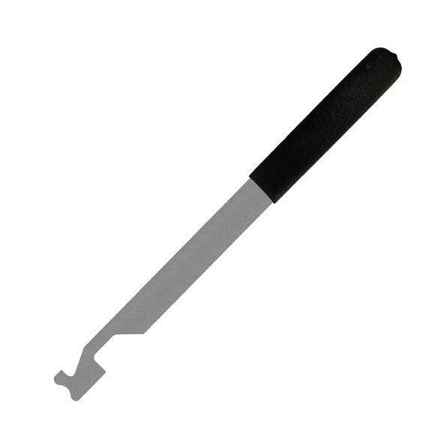
Bypassing Doors
Shims
Traveler hooks
Under the door tools
Air Wedges

Slide 17
Fun Videos
Making an unpickable lock – Stuff Made Here
Making a pickproof lock – Works by Design

Slide 18
Let's try it out!
Everything you use today belongs to the club
Be kind to our equipment
Don’t steal
Be gentle, nothing we’re doing requires force

Slide 19
Time Trials
Compete to see who can pick a series of locks the quickest
Stickers for winners!

